Slide 1

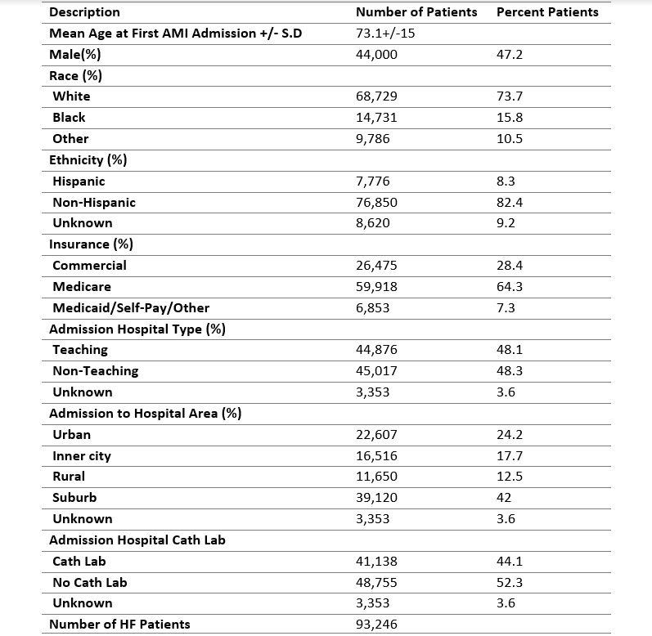
Increase In The Hospital Readmission Rate Among Heart Failure Patients In A Population-Based Study
Michail Giakoumis, Davit Sargsyan, John B. Kostis, Javier Cabrera, Sanketkumar Dalwadi, Georgia Barbayannis, William J. Kostis
For the Myocardial Infarction Data Acquisition System (MIDAS) Study Group
Cardiovascular Institute; Rutgers Robert Wood Johnson Medical School, New Brunswick, NJ, USA
Introduction
Results
Results
It has been reported that patients with heart failure (HF) who are discharged have a high rate of readmission. The time trends of readmission, cardiovascular (CV) mortality, and all-cause death have not been adequately explored.
Data analysis identified admission to a hospital without cardiac catheterization laboratory, hospital located in inner city, non-teaching hospital, Medicare/Medicaid, as well as black race, male gender, history of MI, chronic obstructive pulmonary disease (COPD), diabetes, hypertension or stroke (p<0.001 for all) as predictors of readmission for HF.
Age, male gender, length of stay, history of MI, anemia, COPD, hypertension, stroke, and hospitalization in non-teaching hospital were associated with CV mortality (p<0.001 for all).
FIGURE 2: Trends of Cardiovascular Outcomes in Heart Failure Patients. All-cause readmissions increased significantly during the period of observation.
Hypothesis
We hypothesize that the rate of HF readmissions increased during the study period while the rate of CV mortality decreased.
Methods
This study includes 89,738 patients who were discharged alive with a diagnosis of HF between January 1, 2000, and December 31, 2014. Data were obtained from the Myocardial Infarction Data Acquisition System (MIDAS), a statewide database of all hospitalizations for CV diseases in New Jersey with longitudinal follow-up for more than 20 years.
HF was identified by ICD-9 code 428.xx, and CV mortality was identified by ICD-10-CM codes from I00 to I78.
The temporal trends in the rate of HF specific and all-cause readmission as well as CV and all-cause mortality at 30, 90, 180-days and 1-year were examined using multivariable logistic regression models.
FIGURE 1: Number of first heart failure admissions per year (2000-2014). The number of heart failure admissions declined between 2000 and 2006 and remained relatively stable thereafter.
Conclusions
TABLE 1: Demographics and Clinical Characteristics
Between 2000 and 2014 the rate of all-cause and heart failure readmissions increased among patients with HF.
All-cause and cardiovascular mortality did not change significantly during the period of observation.
This trend could be due to more sensitive diagnostic criteria and higher rate of comorbidities
Disclosures
The authors have no disclosures pertinent to this work.
Cardiovascular Institute, Rutgers Robert Wood Johnson Medical School; Rutgers, The State University of New Jersey

